Slide 1
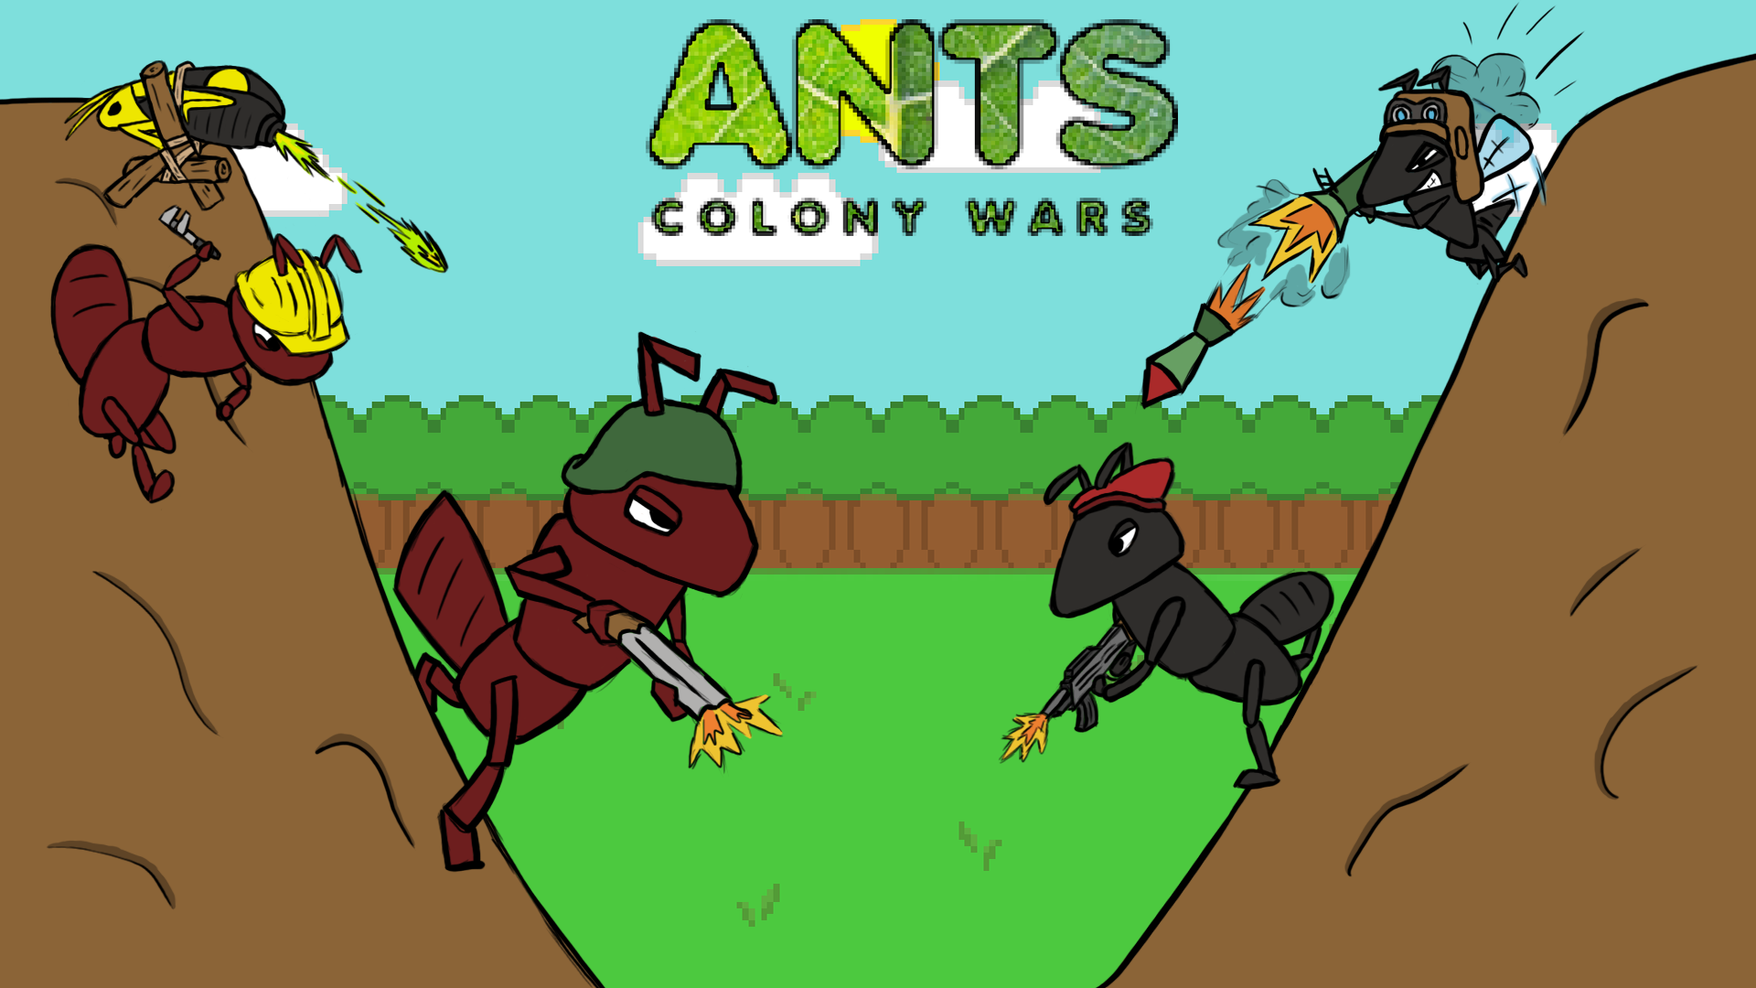

Slide 2
Game Synopsis (Stanley)
Ants: Colony wars is a 2D puzzle tactical artillery shooter. The game consists of two stages, a preparation stage (stage 1) and a combat stage (stage 2) inspired by the games ‘Lemmings’ and ‘Worms’ retrospectively.

Slide 3
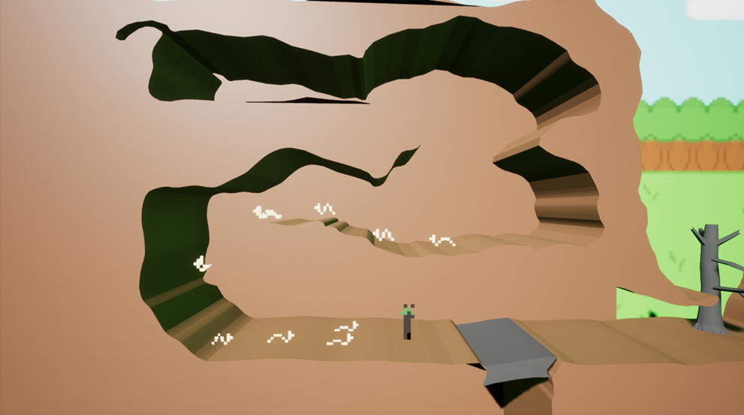
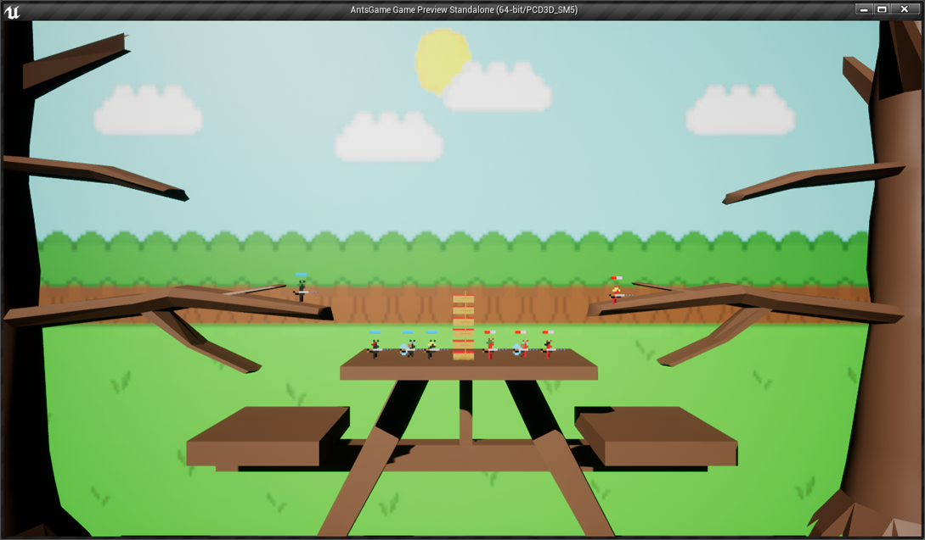
Features in more detail (Stanley)
The first level is the preparation stage where the player has to guide numerous grubs throughout the stage whilst avoiding hazards (such as sudden drops or harmful water) using a main ant character. Once the grubs have either made it to the end of the level or perished along the way, the player is then transported to the second level (the combat stage)
In the combat stage two players then have to fight each other using a collection of different ant characters each with their own look and unique abilities. Each player gets more health depending on how many grubs the player kept alive in the first stage. Using each character in a turn based style, the player has to eliminate their opponents dotted around the level.

Slide 4
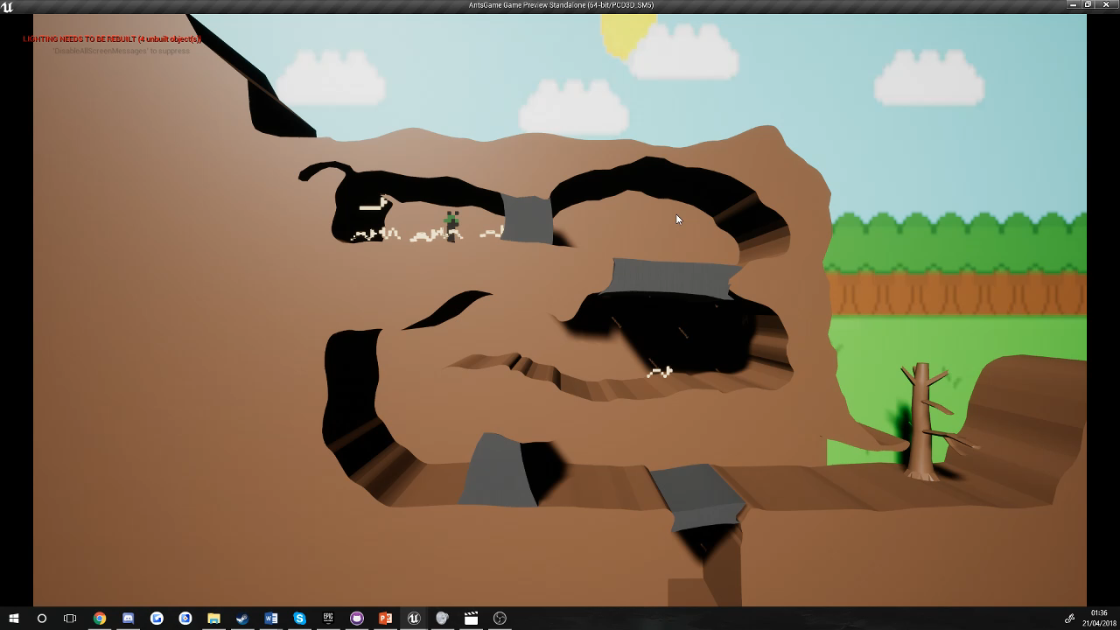
Gameplay from each level 1 (Stanley)

Slide 5
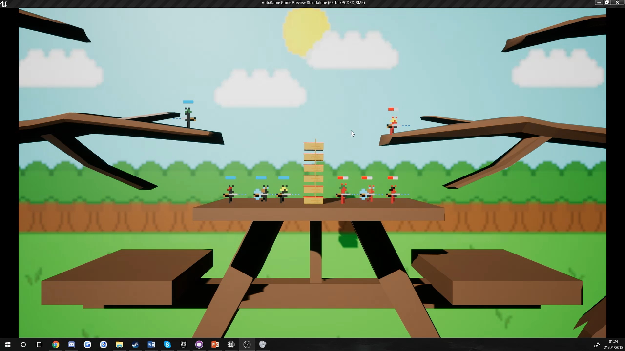
Gameplay from each level 2 (Stanley)

Slide 6
Sprites and characters (Harry)
Describe the characters, their looks and abilities.

Slide 7
Concept art from paper to engine (Harry)
Screenshots of concept art for sprites
Screenshots/gifs of sprites in engine
Side by side comparison.

Slide 8
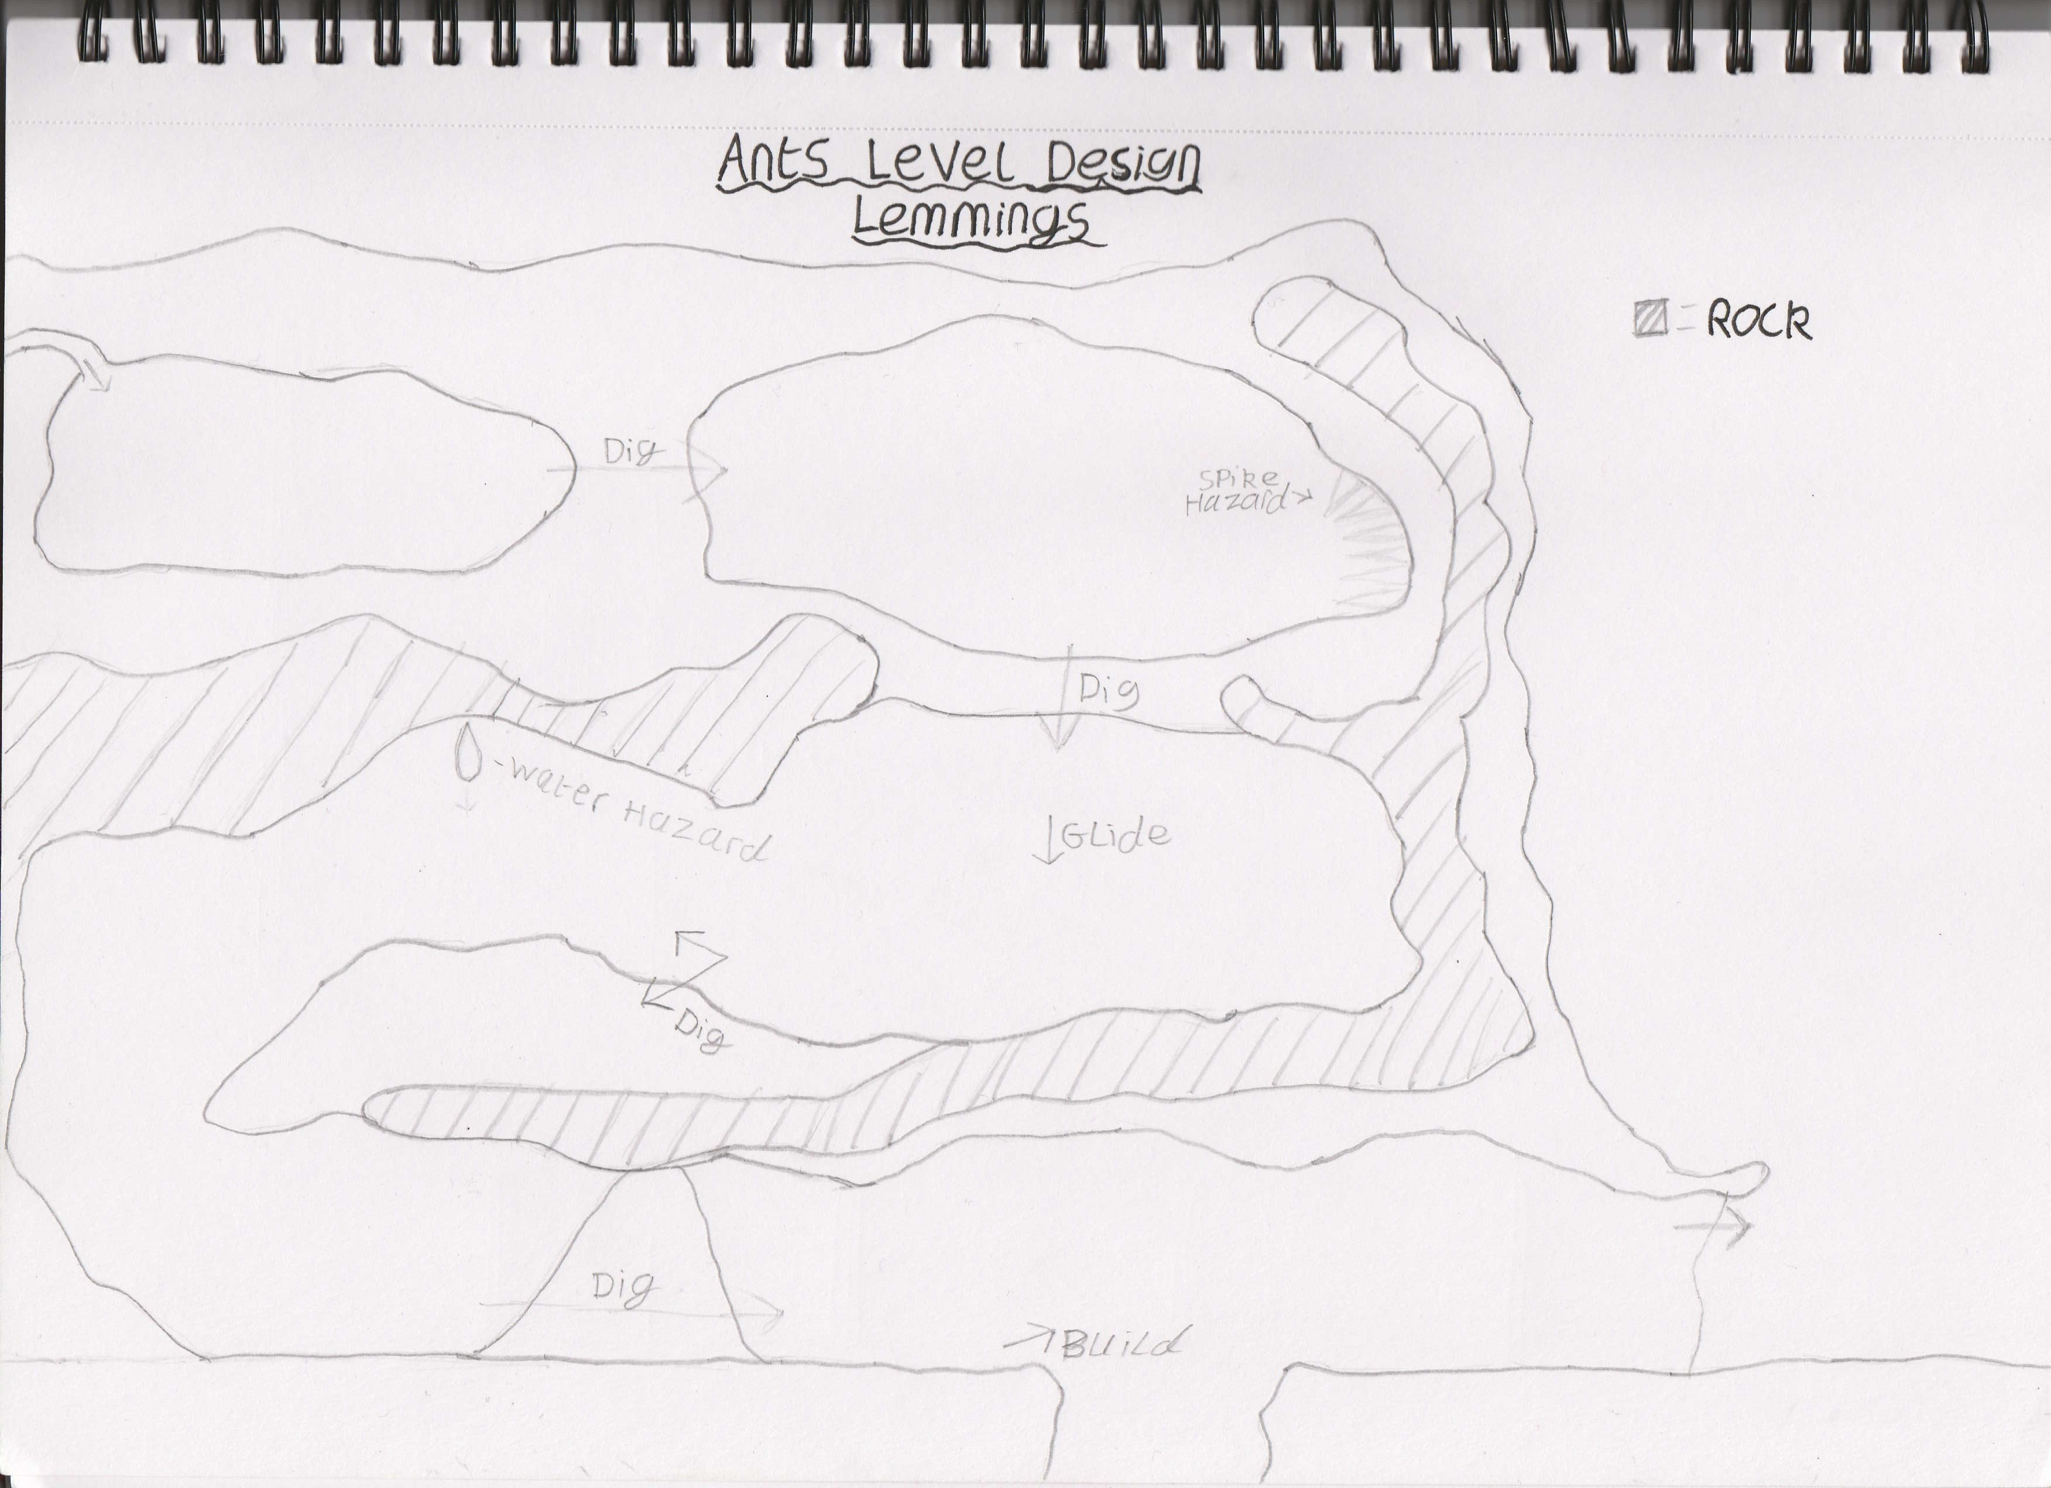
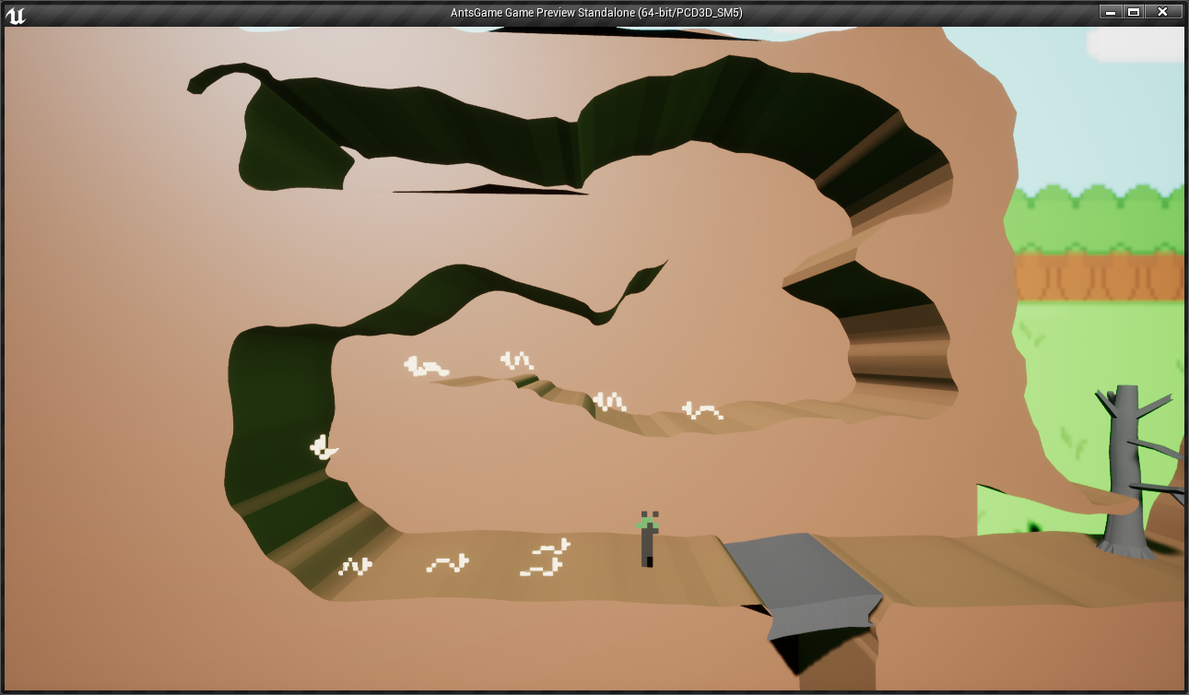
Level design from concept to engine

Slide 9
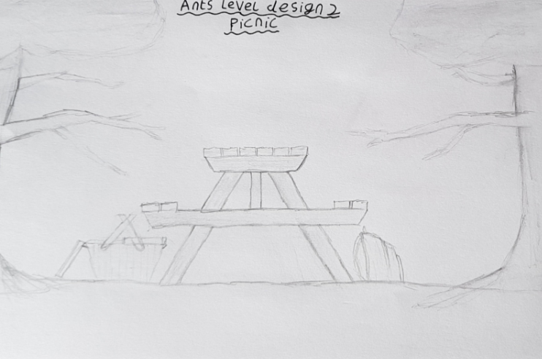

Level design from concept to engine (Stanley)

Slide 10
Extra features added (Danny)
Due to having more time than anticipated we were able to create more feature for our game, these being:
Destructible Terrain
Additional Sprites
More art

Slide 11
Bugs – Coding (Gary)
There was bug with the original health bars where only the first ant blueprint in the game would have a working health bar; this was due to the health bar being bound to this ant. This issue was solved by instead of binding the health bar to an ant, the ant blueprint would instead cast to the health bar, this allowed for functioning individual health bars all using the same blueprint.
There were numerous bugs where the editor would return errors when trying to delete things that were already being destroyed, for example the rocks in the first level and bullets in the dead zone of the second level. This bug was largely fixed by adding a delay after each destroy command to let it work and prevent them from stacking up on the same object as they would run on each tick.

Slide 12
Bugs – Graphics (Gary)
There were issues with the original picnic table where the ants would slip off of the table during gameplay even though it seemed as if they shouldn’t, this was due to the fact that the table was slightly uneven. This was fixed by recreating the table in 3DS Max.
There was a bug involving the death animation of the ants where when an ant reached 0 health instead of playing the death animation fully, only one frame would be displayed. This was fixed by making the death animation one of the flipbook states of the sprite which would be applicated on death, rather the just trying to change activate it directly through a blueprint.
There was a bug in one of the later iterations of our demo which involved players being knocked out of the play area at high speeds when near an exploding destructible item. This was due to the collision properties of the debris and was fixed by setting the debris to pass through the players instead of colliding with them.

Slide 13
Conclusion (Danny)
What we learnt
Team dynamics
What went well
What could’ve been better
How we felt about the game

Slide 14
Overall Thoughts

